Slide 1
LHL Tableau Project
Presentation

Slide 2
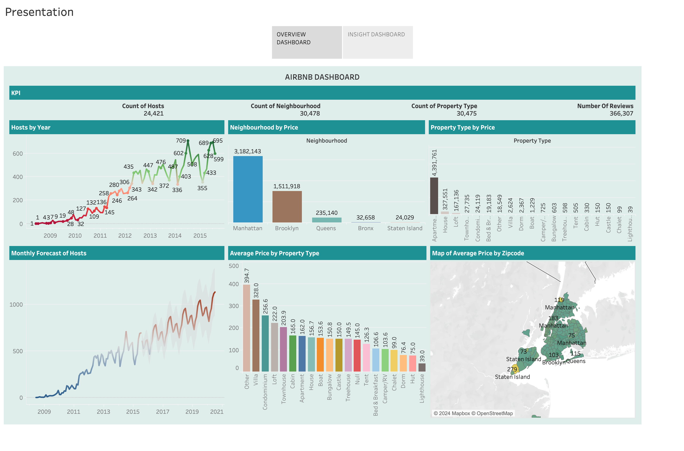

Slide 3
